Slide 1


Emuejevoke Eshemitan
18/09/2022

Slide 2

Outline
Executive Summary
Introduction
Methodology
Results
Conclusion
Appendix

Slide 3
Executive Summary
Summary of methodologies
Data Collection
Data Wrangling
Exploratory Data Analysis with SQL
Exploratory Data Analysis with Data Visualization
Interactive Visual Analysis with Plotly, Folium and Dash
Machine Learning Prediction
Summary of all results
Exploratory Data Analysis Results
Predictive Analysis Results

Slide 4
Introduction
Project background and context
SpaceX advertises Falcon 9 rocket launches on its website with a cost of 62 million dollars;
other providers cost upwards of 165 million dollars each, much of the savings is because
SpaceX can reuse the first stage. Therefore, if we can determine if the first stage will land, we can determine the cost of a launch. Spaces X’s Falcon 9 launch like regular rockets.
Problems you want to find answers
What factors determine if the rocket will land successfully?
Where is the best place to make launches
What operating conditions needs to be in place to ensure a successful landing program

Slide 5

Section 1

Slide 6
Methodology
Executive Summary
Data collection methodology:
Data was collected using SpaceX API and web scraping from Wikipedia
Perform data wrangling
One-hot encoding was done to categorical features
Perform exploratory data analysis (EDA) using visualization and SQL
Perform interactive visual analytics using Folium and Plotly Dash
Perform predictive analysis using classification models
How to build, tune, evaluate classification models

Slide 7
Data Collection
Data sets were collected from Space X API (https://api.spacexdata.com/v4/rockets/) and from Wikipedia (https://en.wikipedia.org/wiki/List_of_Falcon/_9/_and_Falcon_Heavy_launches), using web scraping technics.

Slide 8
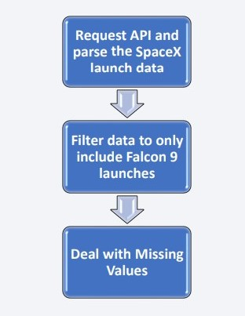
Data Collection – SpaceX API
We used the get request to the SpaceX API to collect data, clean the requested data and did some basic data wrangling and formatting.
GitHub URL:
https://github.com/Davidsonity/IBM-Applied-Data-Science-Capstone/blob/main/Data%20Collection-API.ipynb

Slide 9
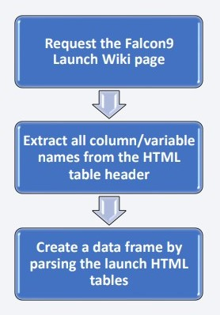
Data Collection - Scraping
We applied web scrapping to Web scrap Falcon 9 launch records with BeautifulSoup
We parsed the table and converted it into a pandas data frame
GitHub URL:
https://github.com/Davidsonity/IBM-Applied-Data-Science-Capstone/blob/main/Data%20Collection-Webscraping.ipynb

Slide 10
Data Wrangling
Initially some Exploratory Data Analysis (EDA) was performed on the dataset.
Then the summaries launches per site, occurrences of each orbit and occurrences of mission outcome per orbit type were calculated.
Finally, the landing outcome label was created from Outcome column. Describe how data were processed
GitHub URL:
https://github.com/Davidsonity/IBM-Applied-Data-Science-Capstone/blob/main/Data%20Wrangling.ipynb

Slide 11
EDA with Data Visualization
We explored the data by visualizing the relationship between flight number and launch Site, payload and launch site, success rate of each orbit type, flight number and orbit type, the launch success yearly
GitHub URL:
https://github.com/Davidsonity/IBM-Applied-Data-Science-Capstone/blob/main/EDA%20with%20Visualization.ipynb

Slide 12
EDA with SQL
We loaded the SpaceX dataset into a PostgreSQL database without leaving the jupyter notebook.
We applied EDA with SQL to get insight from the data. We wrote queries to find out for instance:
The names of unique launch sites in the space mission.
The total payload mass carried by boosters launched by NASA (CRS)
The average payload mass carried by booster version F9 v1.1
The total number of successful and failure mission outcomes
The failed landing outcomes in drone ship, their booster version and launch site names.
GitHub URL: https://github.com/Davidsonity/IBM-Applied-Data-Science-Capstone/blob/main/EDA%20with%20SQL.ipynb

Slide 13
Build an Interactive Map with Folium
We marked all launch sites, and added map objects such as markers, circles, lines to mark the success or failure of launches for each site on the folium map.
We assigned the feature launch outcomes (failure or success) to class 0 and 1.i.e., 0 for failure, and 1 for success.
Using the color-labeled marker clusters, we identified which launch sites have relatively high success rate.
We calculated the distances between a launch site to its proximities. We answered some question for instance:
Are launch sites near railways, highways and coastlines.
Do launch sites keep certain distance away from cities.
GitHub URL:
https://github.com/Davidsonity/IBM-Applied-Data-Science-Capstone/blob/main/Interactive%20Visual%20Analysis%20with%20Folium.ipynb

Slide 14
Build a Dashboard with Plotly Dash
We built an interactive dashboard with Plotly dash
We plotted pie charts showing the total launches by a certain sites
We plotted scatter graph showing the relationship with Outcome and Payload Mass (Kg) for the different booster version.
GitHub URL:
https://github.com/Davidsonity/IBM-Applied-Data-Science-Capstone/blob/main/spacex_dash_app.py

Slide 15
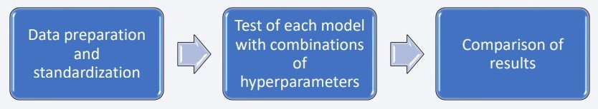
Predictive Analysis (Classification)
Four classification models were compared: logistic regression, support vector machine, decision tree and k nearest neighbors.
GitHub URL:
https://github.com/Davidsonity/IBM-Applied-Data-Science-Capstone/blob/main/Machine%20Learning%20Prediction.ipynb

Slide 16
Results
Exploratory data analysis results
Space X uses 4 different launch sites;
The first launches were done to Space X itself and NASA
The average payload of F9 v1.1 booster is 2,928 kg
The first success landing outcome happened in 2015 fiver year after the first launch
Many Falcon 9 booster versions were successful at landing in drone ships having payload above the average
Almost 100% of mission outcomes were successful
Two booster versions failed at landing in drone ships in 2015: F9 v1.1 B1012 and F9 v1.1 B1015
The number of landing outcomes became as better as years passed.

Slide 17
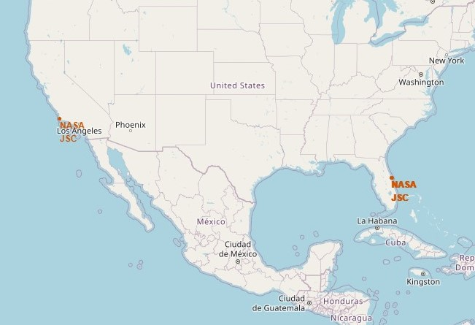
Results
Interactive analytics demo in screenshots
Using interactive analytics was possible to identify that launch sites use to be in safety places, near sea, for example and have a good logistic infrastructure around. • Most launches happens at east coast launch sites.

Slide 18
Results
Predictive analysis results
Predictive Analysis showed that Decision Tree Classifier is the best model to predict successful landings, having accuracy over 87% and accuracy for test data over 94%.

Slide 19

Section 2

Slide 20
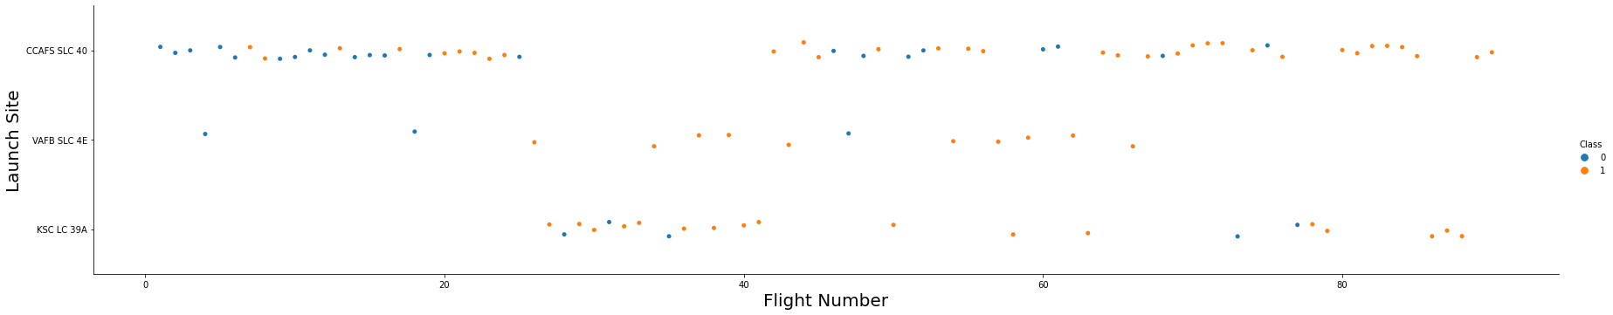
Flight Number vs. Launch Site
From the plot, we found that the larger the flight amount at a launch site, the greater the success rate at a launch site.

Slide 21
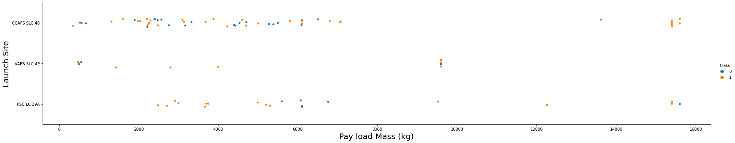
Payload vs. Launch Site
The greater the payload mass for launch site CCAFS SLC 40 the higher the success rate for the rocket.

Slide 22
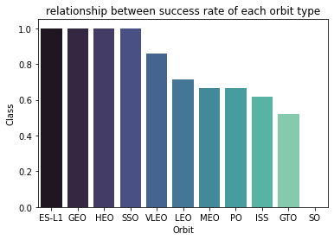
Success Rate vs. Orbit Type
From the plot, we can see that ES-L1, GEO, HEO, SSO, VLEO had the most success rate.

Slide 23
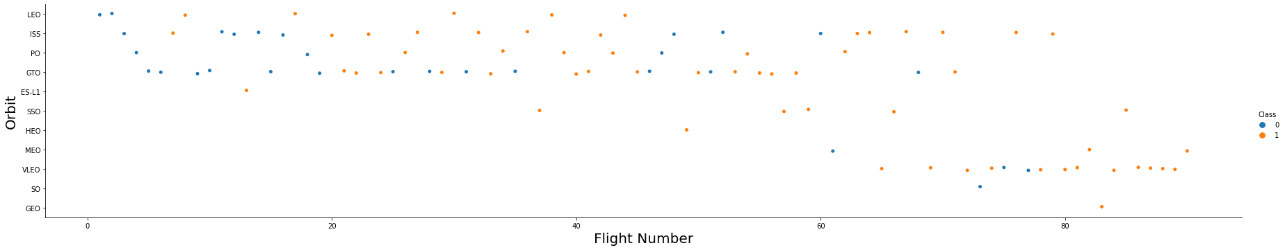
Flight Number vs. Orbit Type
The plot below shows the Flight Number vs. Orbit type. We observe that in the LEO orbit, success is related to the number of flights whereas in the GTO orbit, there is no relationship between flight number and the orbit.

Slide 24
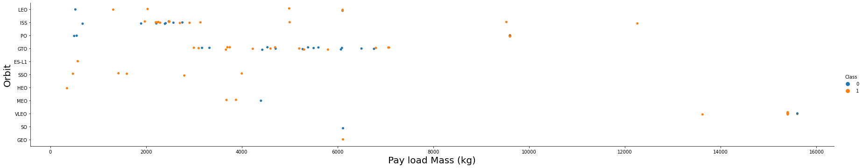
Payload vs. Orbit Type
We can observe that with heavy payloads, the successful landing are more for PO, LEO and ISS orbits.

Slide 25
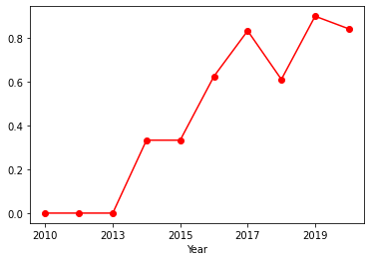
Launch Success Yearly Trend
From the plot, we can observe that success rate since 2013 kept on increasing till 2020.

Slide 26
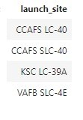
All Launch Site Names
We used the key word DISTINCT to show only unique launch sites from the SpaceX data.

Slide 27
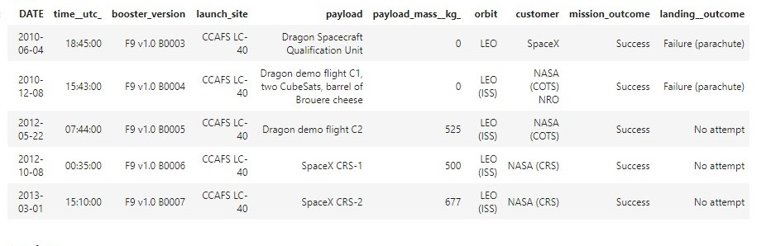
Launch Site Names Begin with 'CCA'
5 records where launch sites begin with `CCA`

Slide 28
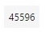
Total Payload Mass
Total payload carried by boosters from NASA
Total payload calculated above, by summing all payloads whose codes contain ‘CRS’, which corresponds to NASA.

Slide 29
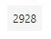
Average Payload Mass by F9 v1.1
Average payload mass carried by booster version F9 v1.1
We calculated the average payload mass carried by booster version F9 v1.1 as 2928

Slide 30
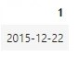
First Successful Ground Landing Date
The dates of the first successful landing outcome on ground pad
We observed that the dates of the first successful landing outcome on ground pad was 22nd December 2015

Slide 31
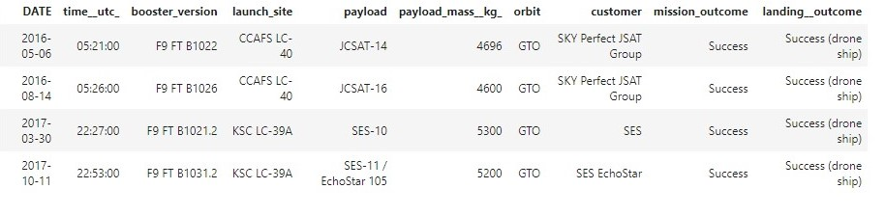
Successful Drone Ship Landing with Payload between 4000 and 6000
Names of boosters which have successfully landed on drone ship and had payload mass greater than 4000 but less than 6000
We used the WHERE clause to filter for boosters which have successfully landed on drone ship and applied the AND condition to determine successful landing with payload mass greater than 4000 but less than 6000

Slide 32
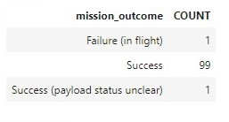
Total Number of Successful and Failure Mission Outcomes
The total number of successful and failure mission outcomes
We used wildcard like ‘%’ to filter for WHERE MissionOutcome was a success or a failure.

Slide 33
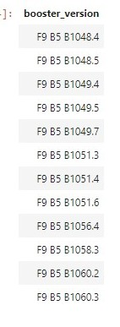
Boosters Carried Maximum Payload
Names of the booster which have carried the maximum payload mass
We determined the booster that have carried the maximum payload using a subquery in the WHERE clause and the MAX() function.

Slide 34
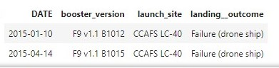
2015 Launch Records
Failed landing_outcomes in drone ship, their booster versions, and launch site names for in year 2015
The list above has the only two occurrences.

Slide 35
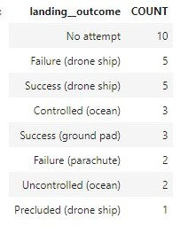
Rank Landing Outcomes Between 2010-06-04 and 2017-03-20
We selected Landing outcomes and the COUNT of landing outcomes from the data and used the WHERE clause to filter for landing outcomes BETWEEN 2010-06-04 to 2010-03-20
We applied the GROUP BY clause to group the landing outcomes and the ORDER BY clause to order the grouped landing outcome in descending order.

Slide 36

Section 3

Slide 37
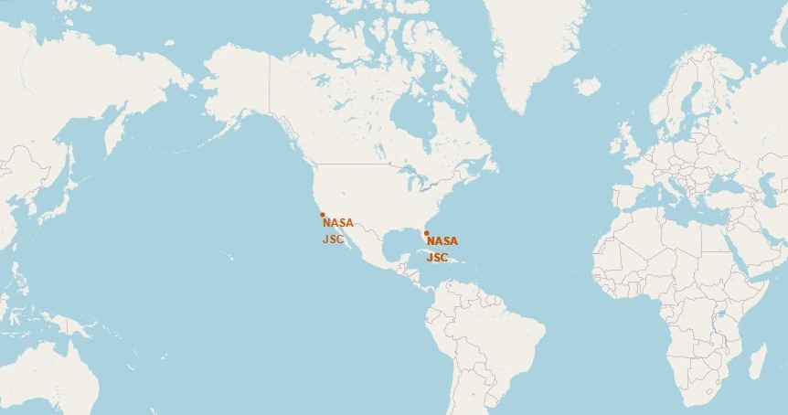
All launch sites global map markers
Launch Sites are in United States of America Coast

Slide 38
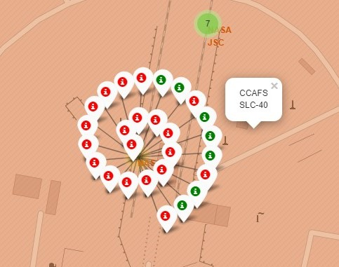
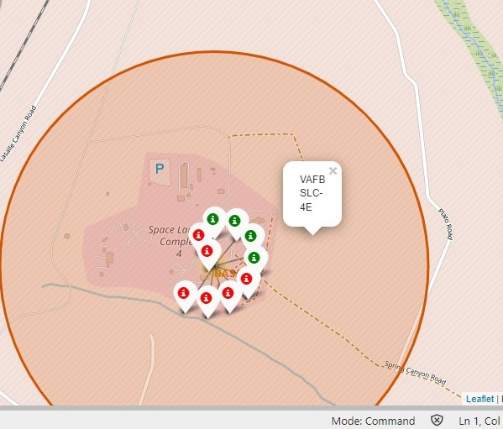
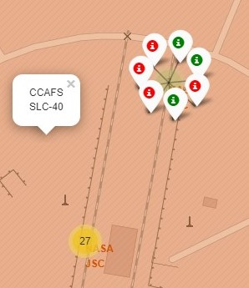
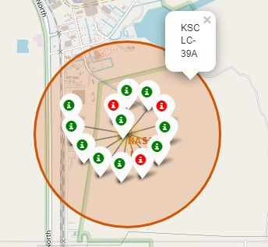
Launch Outcomes by Site
Green marker show successful launches and red marker shows failures

Slide 39
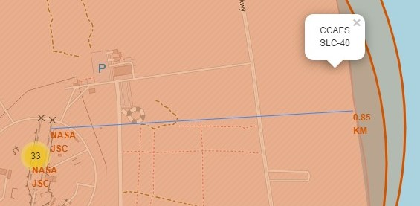
Launch Site distance to Coast
CCAFS SLC-40 Launch site is close to the coast

Slide 40

Section 4

Slide 41
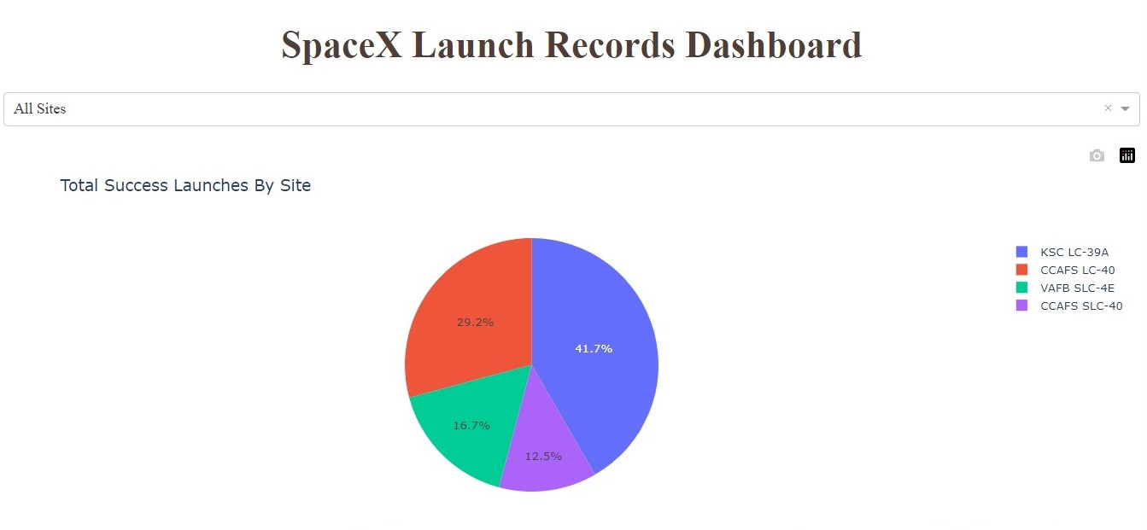
Successful Launches by Site
KSC LC-39A had the most launches from all sites

Slide 42
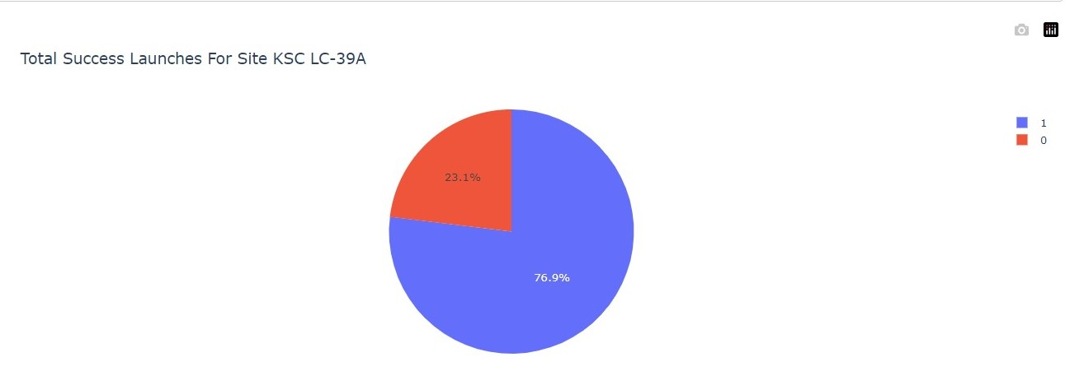
Launch Success Ratio for KSC LC-39A
KSC LC_39A achieved a 76.9% success rate and 23.1% failure rate

Slide 43
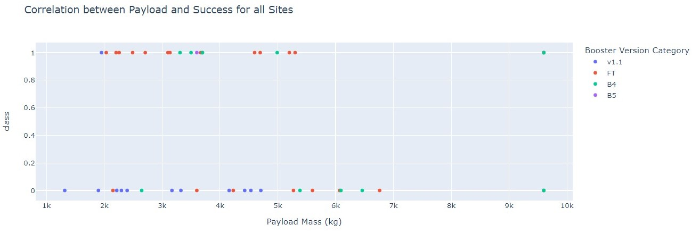
Payload vs. Launch Outcome
Payloads under 6,000kg and FT boosters are the most successful combination.

Slide 44

Section 5

Slide 45
Classification Accuracy
Four classification models were tested, and their accuracies are the same on the test data;
The model with the highest classification accuracy is Decision Tree Classifier, which has accuracies over than 87% on the train data.

Slide 46
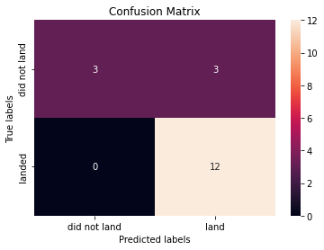
Confusion Matrix
The confusion matrix for the decision tree classifier shows that the classifier can distinguish between the different classes. The major problem is the false positives .i.e., unsuccessful landing marked as successful landing by the classifier.

Slide 47
Conclusions
We can conclude that:
The larger the flight amount at a launch site, the greater the success rate at a launch site.
Launch success rate started to increase in 2013 till 2020.
Orbits ES-L1, GEO, HEO, SSO, VLEO had the most success rate.
KSC LC-39A had the most successful launches of any sites.
The Decision tree classifier is the best machine learning algorithm for this task

Slide 48
Appendix
Folium didn’t show maps on GitHub, so I took screenshots.

Slide 49


